Slide 1
DIVVALA JITHENDRA
Final Project
3/21/2024 Annual Review

Slide 2
PROJECT TITLE
KEYLOGGER AND SECURITY
3/21/2024 Annual Review

Slide 3


AGENDA
Problem Statement
Project Overview
Who are the End Users?
Solution and Its Value Proposition
The 'Wow' in Your Solution
Modelling
Results
Project Link
3/21/2024 Annual Review

Slide 4

PROBLEM STATEMENT
Keyloggers pose a significant threat to information security, with incidents rising by X% in recent years.
They capture keystrokes to steal sensitive information, affecting millions of users globally.
Can be hardware-based or software-based, each with unique detection challenges.
Used by cybercriminals for unauthorized access, leading to significant financial and data losses.
3/21/2024 Annual Review

Slide 5

PROJECT OVERVIEW
Objective:
Develop solutions to identify, mitigate, and prevent keylogger attacks.
Detection Mechanisms: Enhance antivirus software, use machine learning for behavioral analysis, detect hardware keyloggers.
Preventive Measures:
Regular software updates, firewall configurations, secure authentication with 2FA and password managers.
User Education:
Conduct training programs and awareness campaigns on phishing and safe practices.
Response Protocols:
Implement incident response plans, continuous monitoring, and regular security audits.
3/21/2024 Annual Review

Slide 6

WHO ARE THE END USERS?
Cybercriminals: Steal sensitive information for financial gain or identity theft, targeting both individuals and organizations.
Industrial Spies: Gather confidential business information and trade secrets, leading to competitive disadvantages.
Disgruntled Employees: Collect sensitive information for sabotage or personal revenge, often resulting in internal data breaches.
Governments and Intelligence Agencies: Engage in surveillance and intelligence gathering for national security purposes.
Private Investigators: Monitor and gather evidence on suspects, potentially infringing on privacy rights.
3/21/2024 Annual Review

Slide 7

YOUR SOLUTION AND ITS VALUE PROPOSITION
Enhanced Detection Mechanisms: Advanced antivirus, behavioral analysis tools, hardware scanning tools.
Enhanced Security: Reduces the risk of keylogger attacks, protecting sensitive information.
Proactive Protection: Regular updates, firewalls, and secure authentication practices.
User Empowerment: Educate and train users to recognize and avoid keyloggers through awareness programs and hands-on training.
3/21/2024 Annual Review

Slide 8

THE WOW IN YOUR SOLUTION
Cutting-Edge Machine Learning: Detects sophisticated keyloggers by analyzing user behavior patterns and flagging anomalies.
Adaptive Detection: Continuously learns and adapts to new keylogger tactics, staying ahead of emerging threats.
Multi-Layered Defense: Hardware scanning tools, enhanced antivirus, firewall configurations.
Zero-Day Threat Mitigation: Detects and neutralizes unknown keylogger threats before they can cause harm.
3/21/2024 Annual Review
8

Slide 9
MODELLING
Teams cam add wireframes
Machine Learning-Based Behavioral Analysis:
Data Collection: Aggregate data on normal user behaviors and keylogger patterns from diverse sources.
Feature Extraction: Identify key features such as typing speed, unusual key sequences, and other behavioral anomalies.
Model Training: Use advanced algorithms like anomaly detection and neural networks to train the model.
Real-Time Monitoring: Continuously monitors user activities, flags anomalies.
Signature-Based Detection:
Signature Database: Maintain an updated and comprehensive database of known keylogger signatures.
Scanning Tools: Develop and deploy tools to scan systems for these signatures, ensuring timely detection and removal.
3/21/2024 Annual Review
9

Slide 10
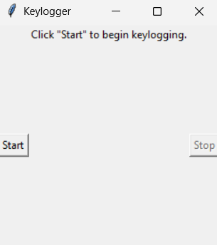
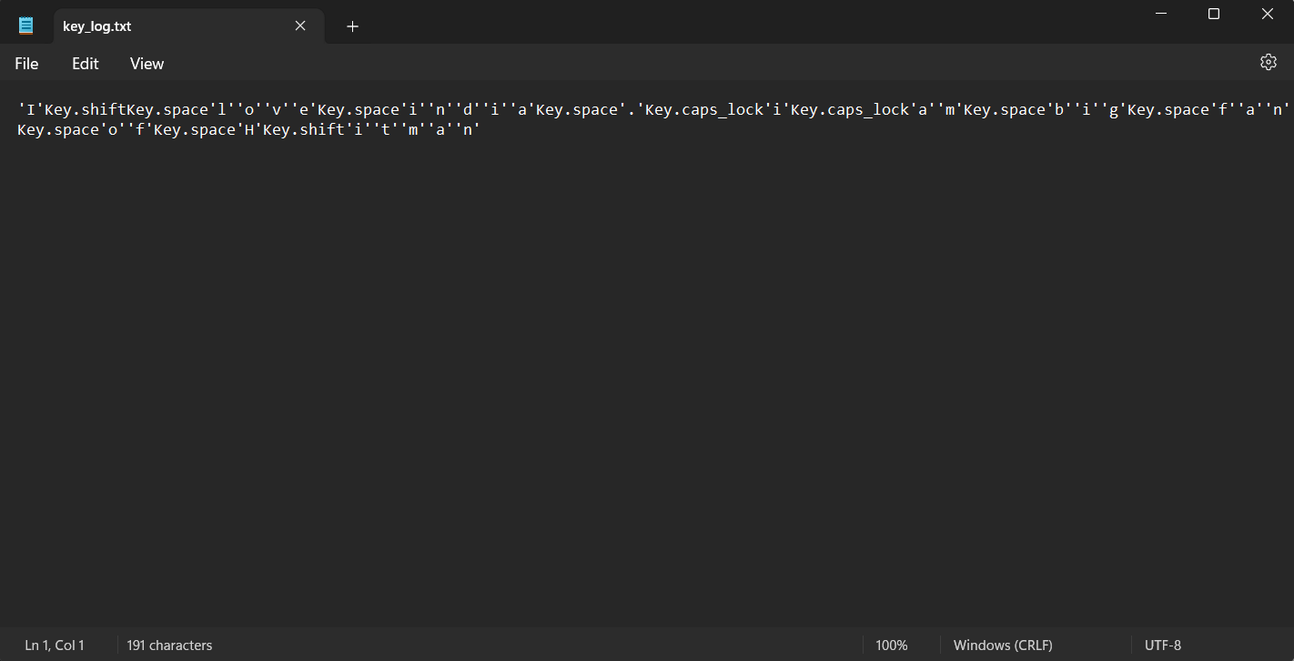
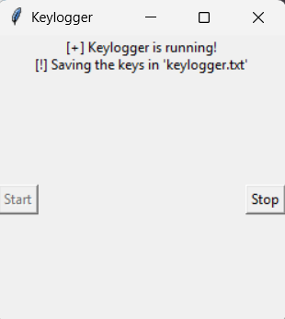
RESULTS
10

Slide 11
PROJECT LINK
https://github.com/jithu4513/keylogger.git

